Slide 1
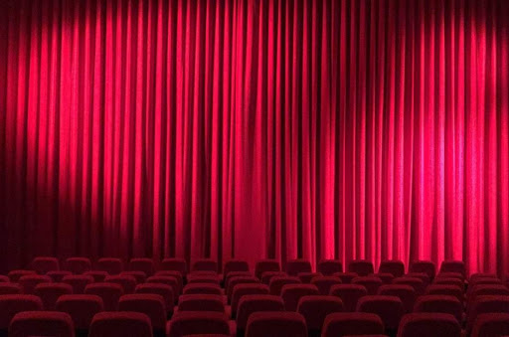
Movie search
IR Project - Stefano Taillefert

Slide 2


Main idea
IR Project - Stefano Taillefert
Step 1: Crawl sites like IMDb, RottenTomatoes, allmovie.com
Step 2: Get movies metadata (title, description, rating, …)
Step 3: Index all the data
Step 4: ?
Step 5: Profit
?

Slide 3

Focus
IR Project - Stefano Taillefert
Simplicity of installation and usage
Versatility and power
Easily extendable

Slide 4
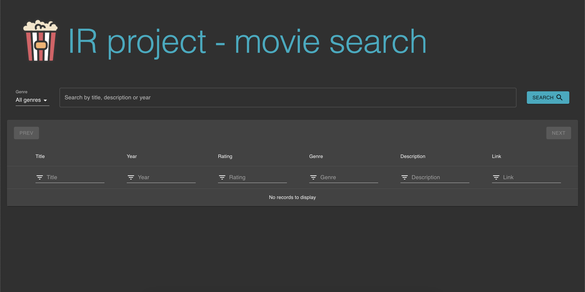
Nice and clean UI
IR Project - Stefano Taillefert

Slide 5


Components
IR Project - Stefano Taillefert
Web
User
Scrape pages
Gets results
Executes query
Crawlers
Backend
Frontend
Post data
Retrieves data

Slide 6





Tech stack
IR Project - Stefano Taillefert

Slide 7
Tech stack (scaled)
IR Project - Stefano Taillefert

Slide 8

Problems encountered
IR Project - Stefano Taillefert
Had to adapt some React components to custom behaviour
Docker networking adds complexity
Enabling clustering broke my Solr

Slide 9


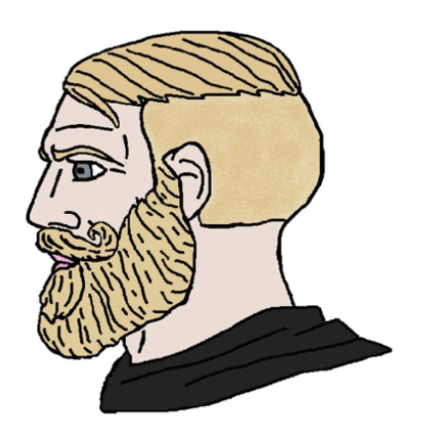
User evaluation
IR Project - Stefano Taillefert
User1 and User2: very good, intuitive, easy to use, nice features
User3: change half of the site because it’s redundant
Me: okay

Slide 10

Questions
IR Project - Stefano Taillefert

Slide 11

Demo time!
IR Project - Stefano Taillefert

